Slide 1
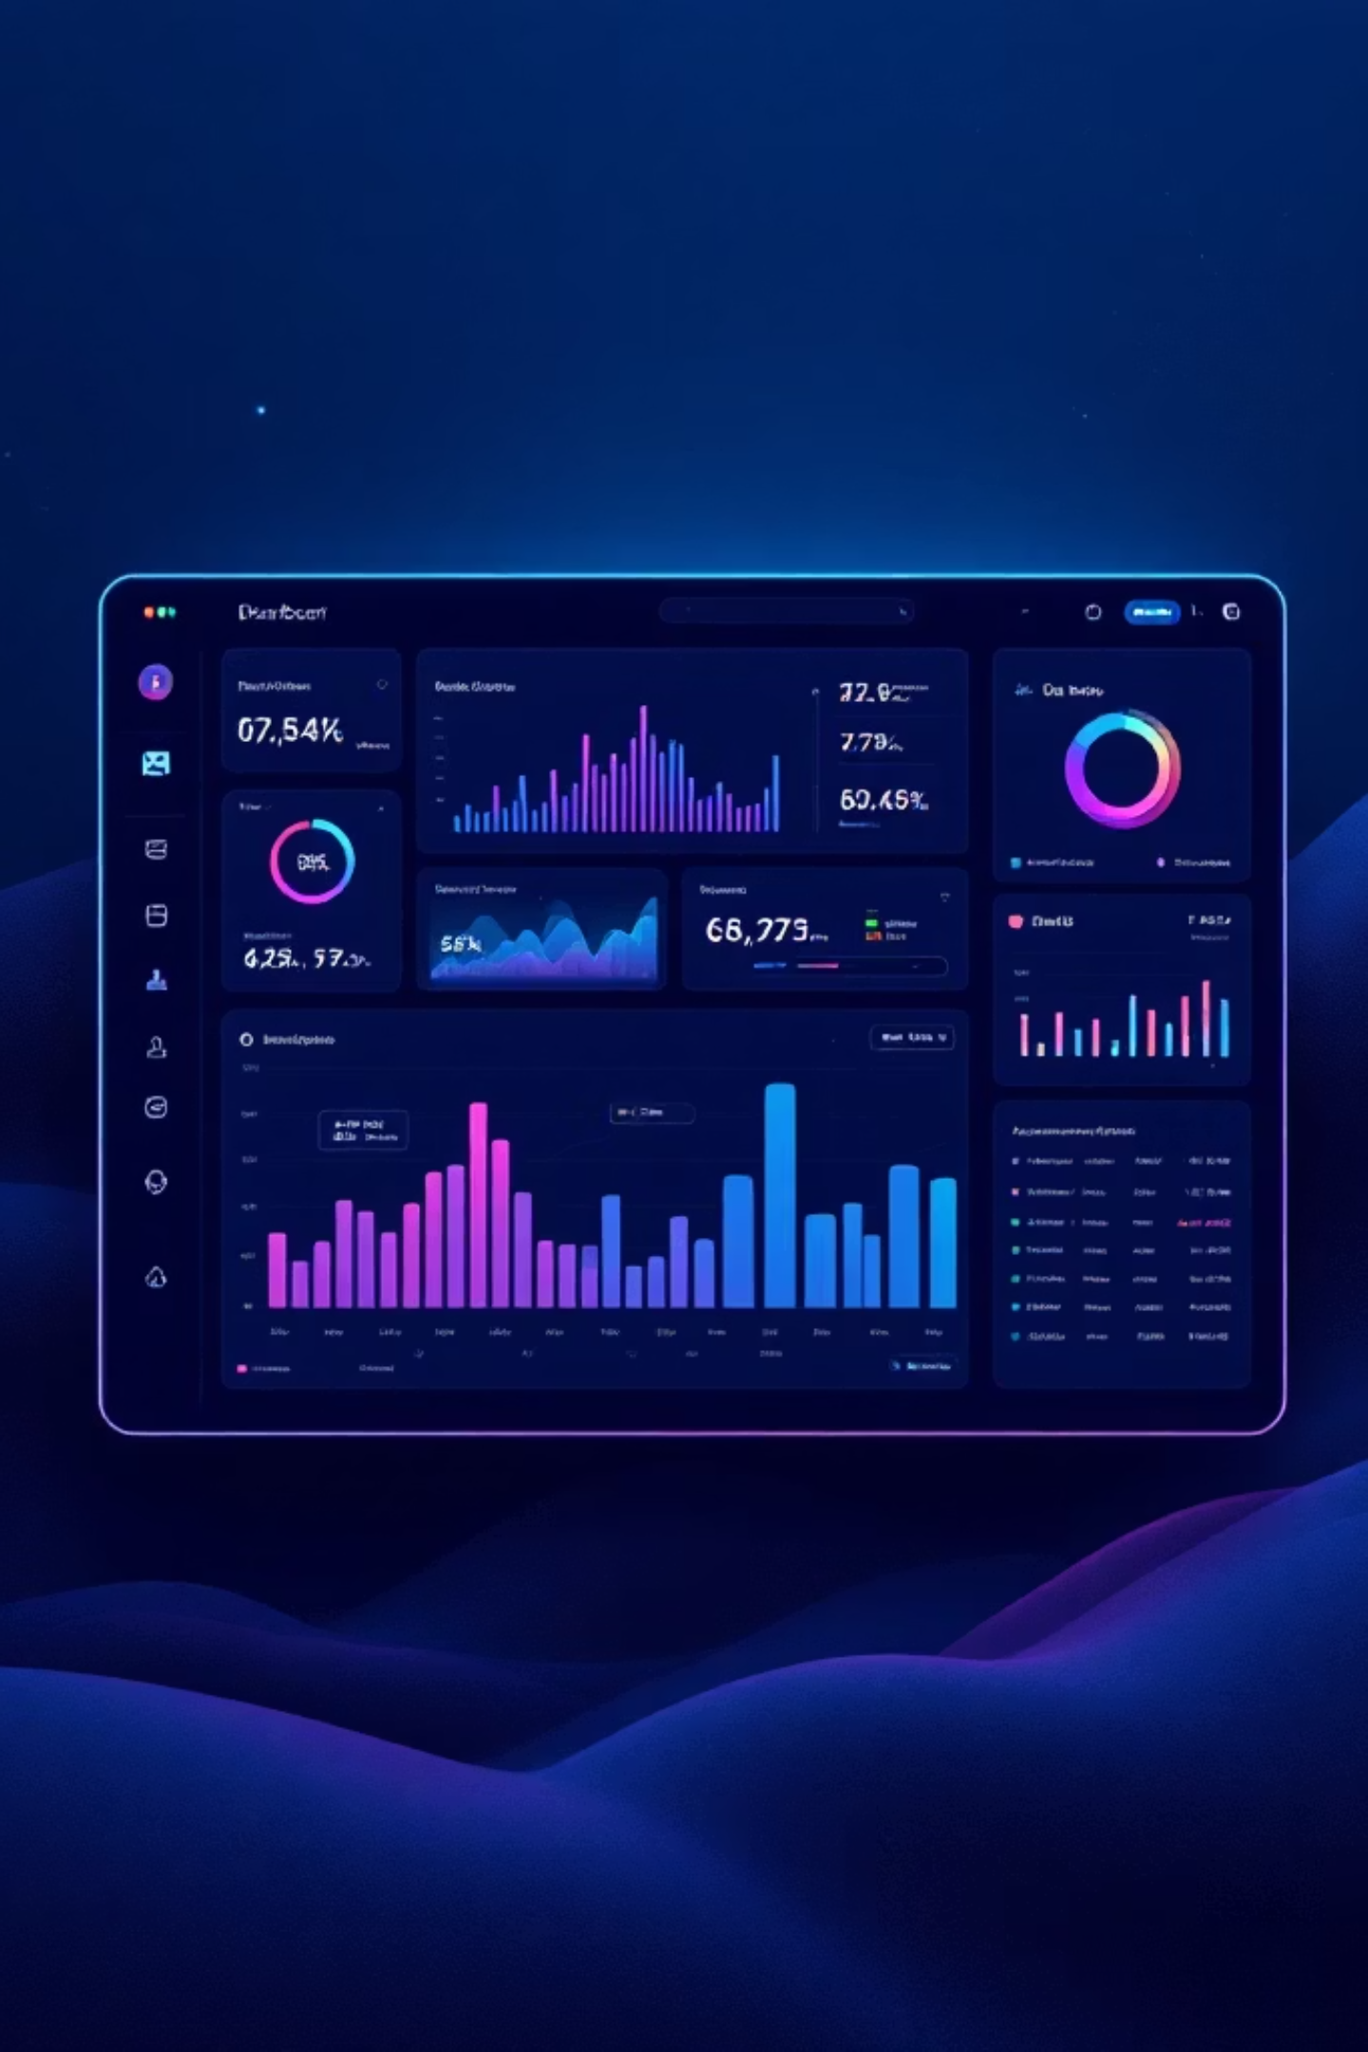
XSplit — Expense Splitter
A sleek, full-featured personal finance and group expense management app. Track daily spending, set budgets, and split bills effortlessly — all in one place.
Team: INNOVEX
Dishanth D Poojary
Meghana Shetty
Pragathi
Prajwal KA

Slide 2
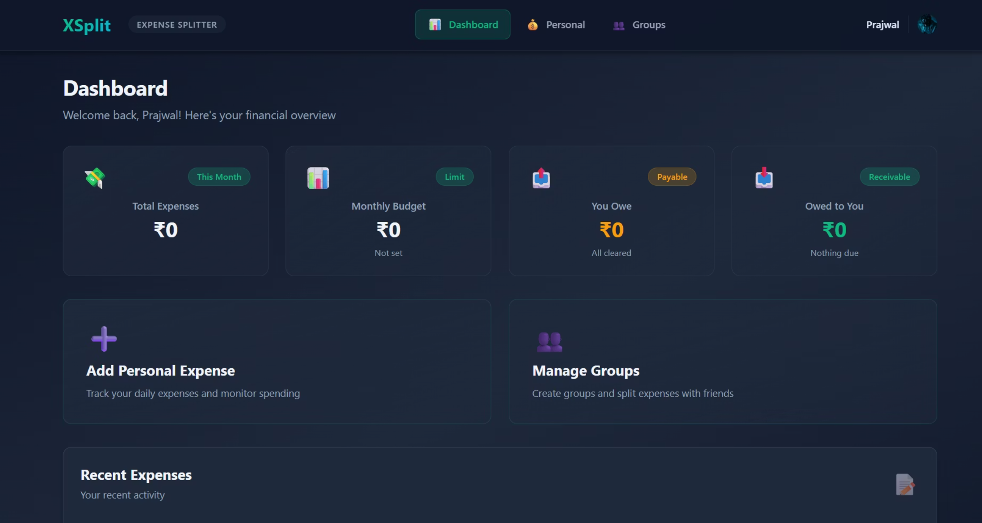
OVERVIEW
Your Financial Command Center
The Dashboard
Get a bird's-eye view of your finances the moment you log in. The dashboard surfaces what matters most — instantly.
Total Expenses
Monthly Budget
You Owe / Owed to You
See your monthly spend at a glance
Track limits and stay on target
Real-time group settlement status

Slide 3
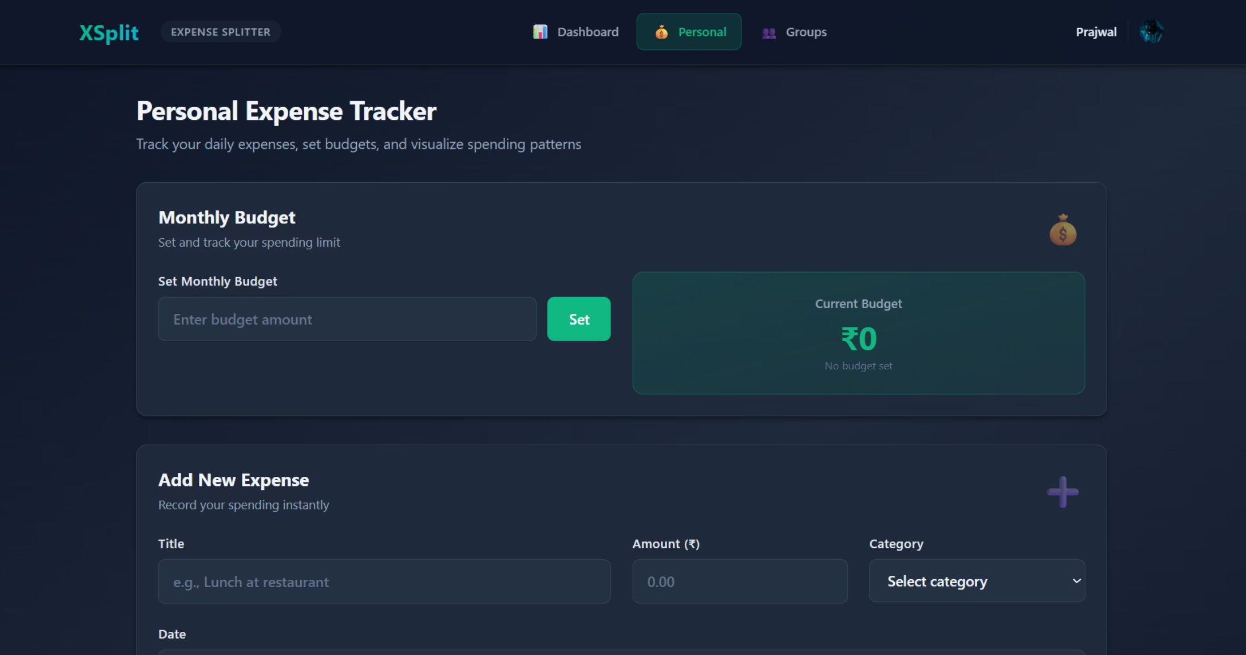
FEATURE
Personal Expense Tracking
Log Every Rupee, Effortlessly
Add expenses in seconds with a title, amount, category, and date. XSplit keeps your spending history organized and always accessible.
Quick-add form with category selector
Set and monitor your monthly budget cap
Visual cues when approaching spending limits
Instant current budget display after entry

Slide 4
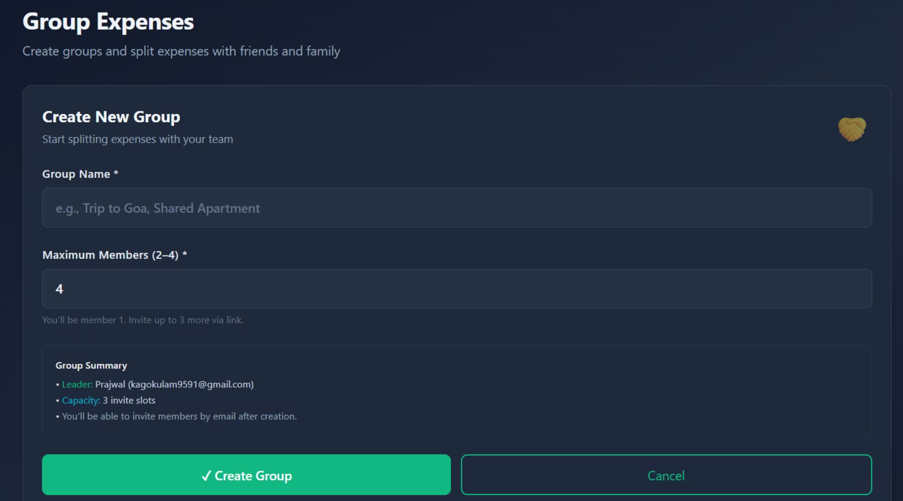
FEATURE
Group Expense Splitting
Split Bills with Friends & Family
Create a group in seconds — name it, set a member cap, and invite others via link or email. Perfect for trips, apartments, and shared meals.
Groups support 2–4 members
Automatic invite slot management
Leader-assigned group ownership
Payable/receivable status at a glance

Slide 5


How XSplit Works
Create Account
Add Expenses
Sign up in seconds
Log costs quickly
Set Your Budget
Split with Groups
Define spending limits
Share bills easily
From onboarding to settlement, XSplit keeps every step intuitive — so you focus on life, not ledgers.

Slide 6
CORE FEATURES
Everything You Need, Nothing You Don't
Budget Management
Expense Logging
Set monthly limits and get real-time feedback on your remaining balance.
Categorize and record every transaction with minimal friction.
Group Splitting
Financial Overview
Create groups, add shared expenses, and track who owes what automatically.
One unified dashboard to monitor personal and group finances side by side.

Slide 7
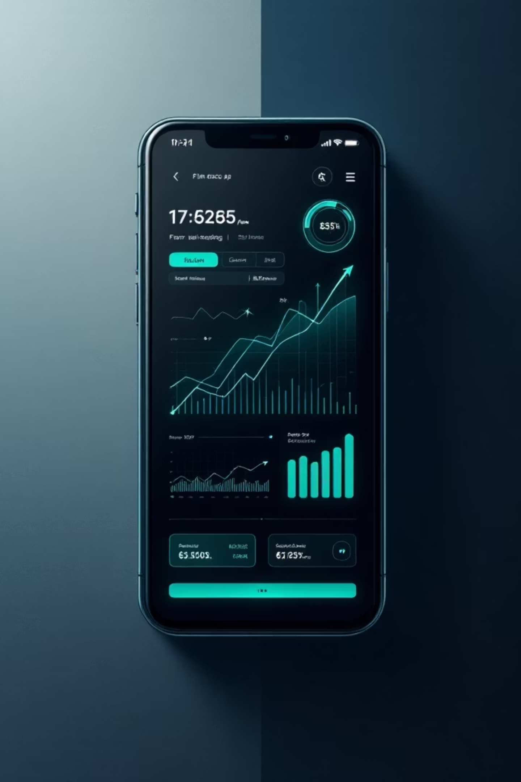
Built for the Way You Live
XSplit combines personal finance discipline with the social reality of shared expenses — a tool designed for modern life, where money is always moving between people.
🌙 Dark-First UI
⚡ Real-Time Updates
Designed for comfort and clarity in any environment
Balances and settlements refresh instantly
🔐 Secure by Design
Your financial data stays private and protected

Slide 8
Thank You

